Slide 1

RNN Applications
Human Activity Recognition
Notes:
1

Slide 2
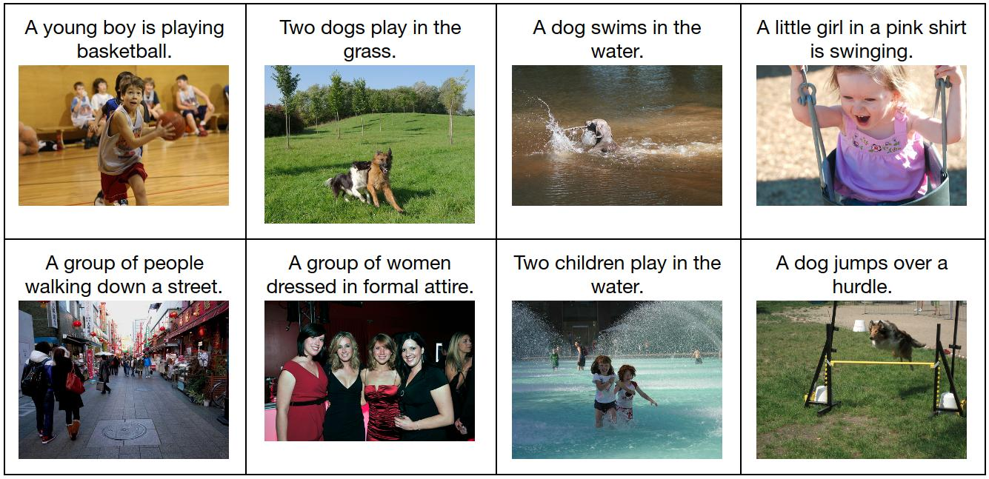
RNN Applications
Image Captioning
Courtesy: Keras-github
Notes:
2

Slide 3

RNN Applications
Machine Translation
Courtesy: ciklopea.com
Notes:
3

Slide 4
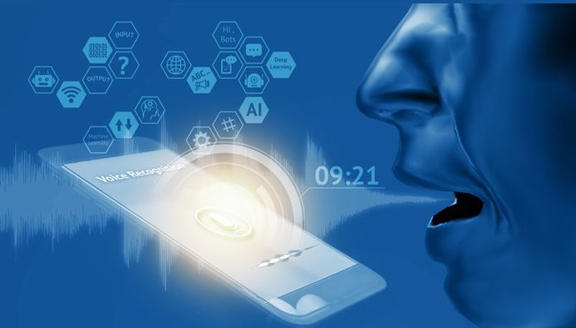
RNN Applications
Speech Recognition
Courtesy: loginworks.com
Notes:
4

Slide 5

RNN Applications
Stock Price Prediction
Courtesy: hackernoon.com
Notes:
5

Slide 6
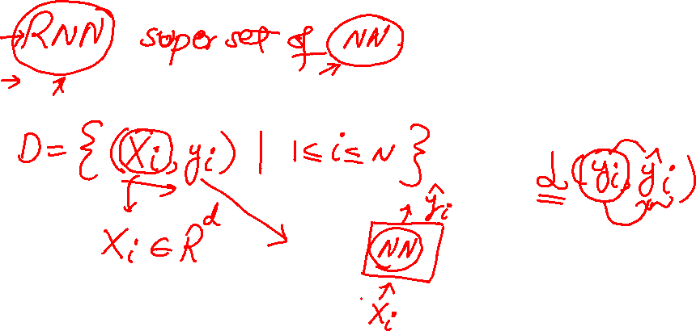
When to model RNN?
Notes:
6

Slide 7
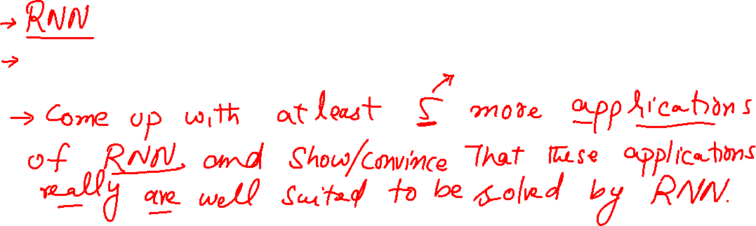
Activity
Notes:
7

Slide 8
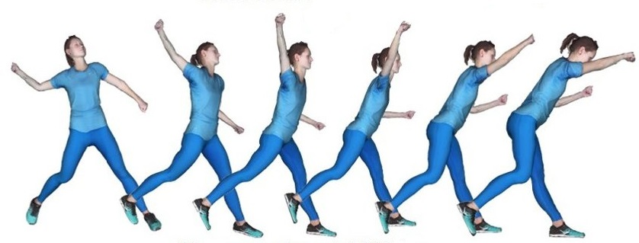
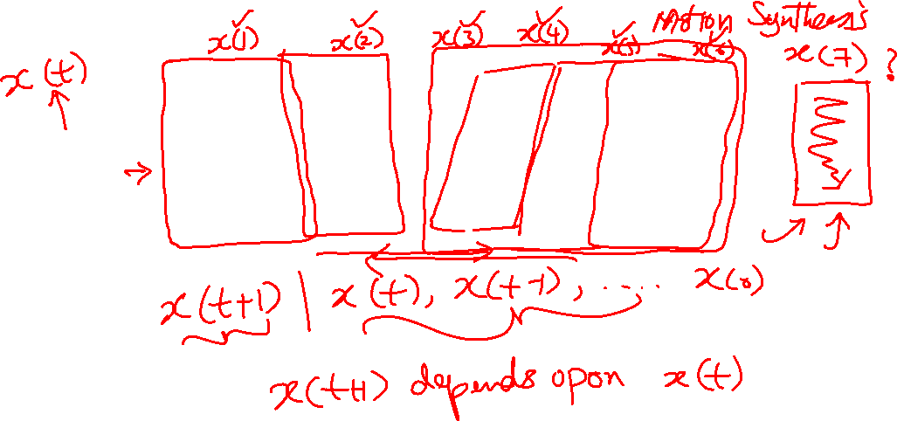
RNN Model
Courtesy: researchgate
Notes:
8

Slide 9
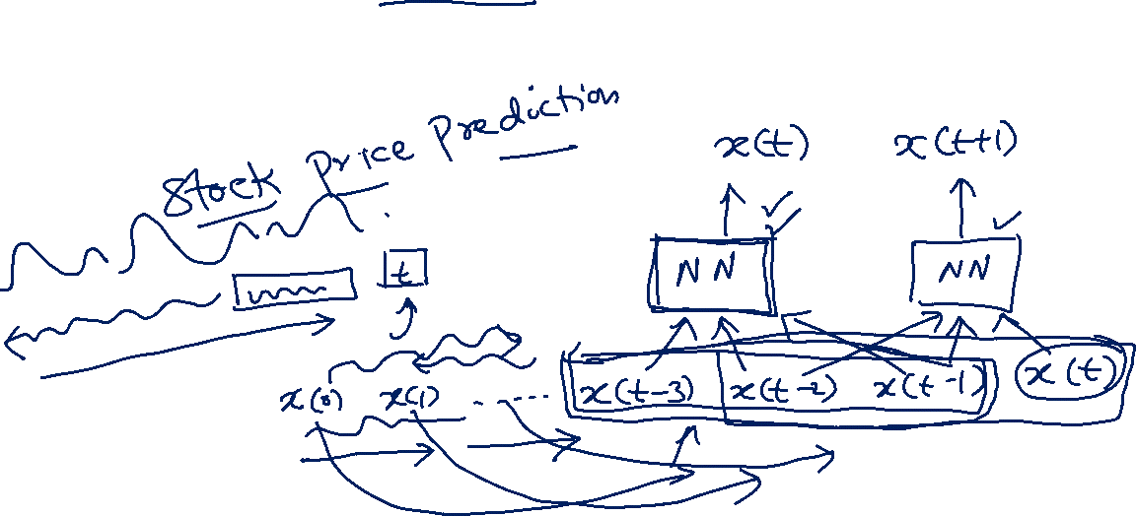
RNN Model
Notes:
9

Slide 10
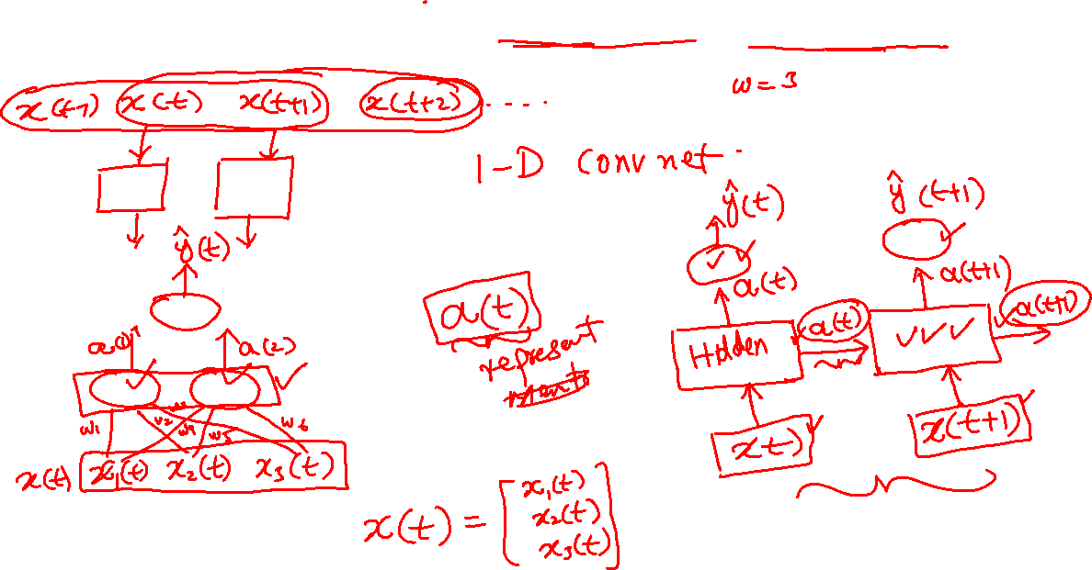
RNN Model (Infinite Memory)
Notes:
10

Slide 11
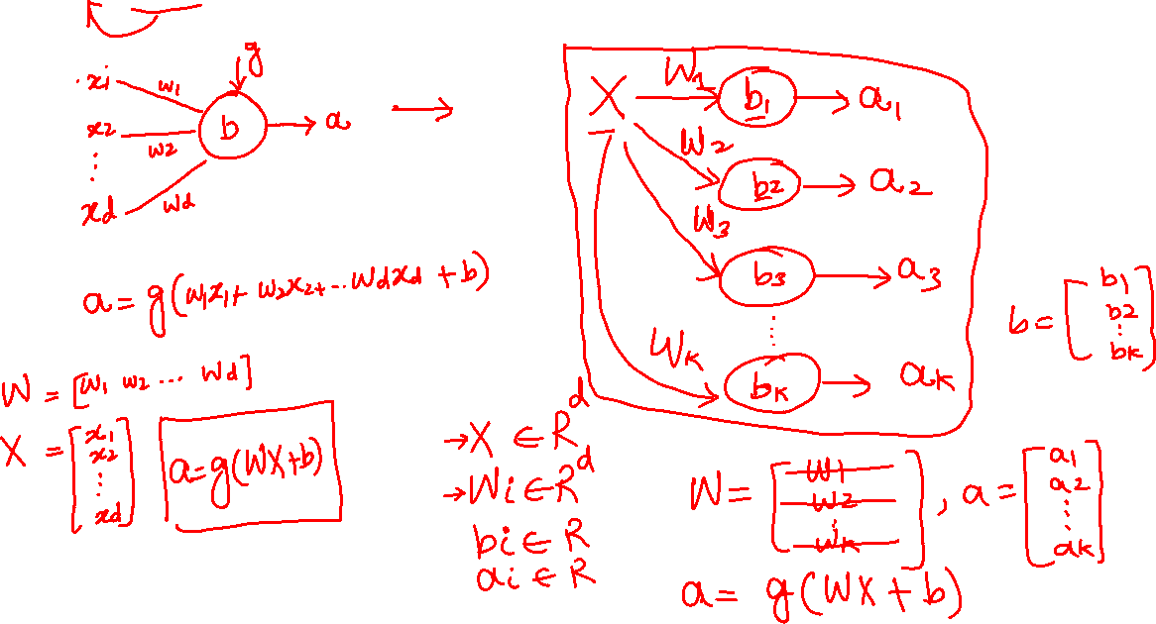
RNN Model (Weight Sharing)
Notes:
11

Slide 12
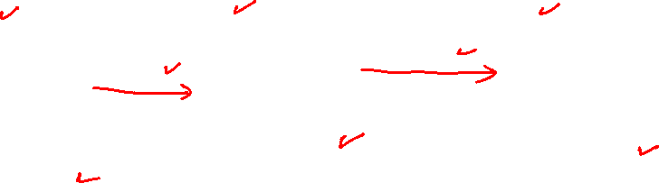
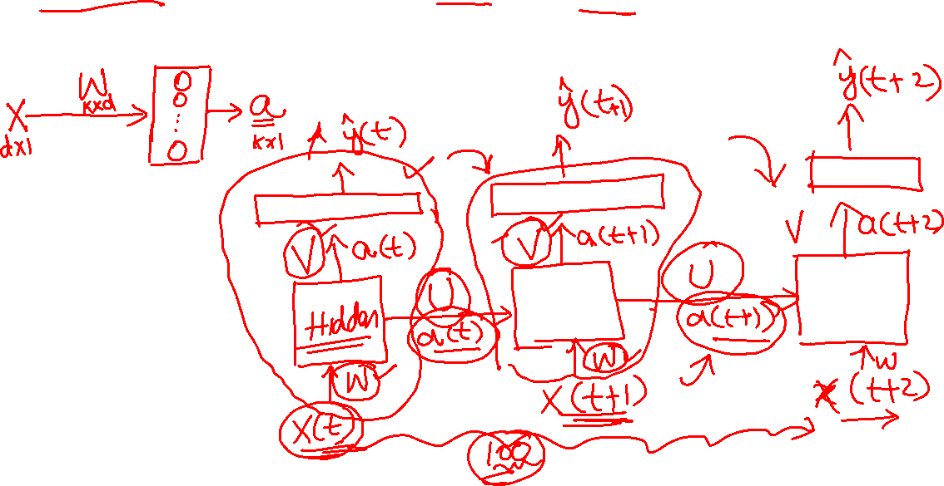
RNN Model (Weight Sharing)
Notes:
12

Slide 13
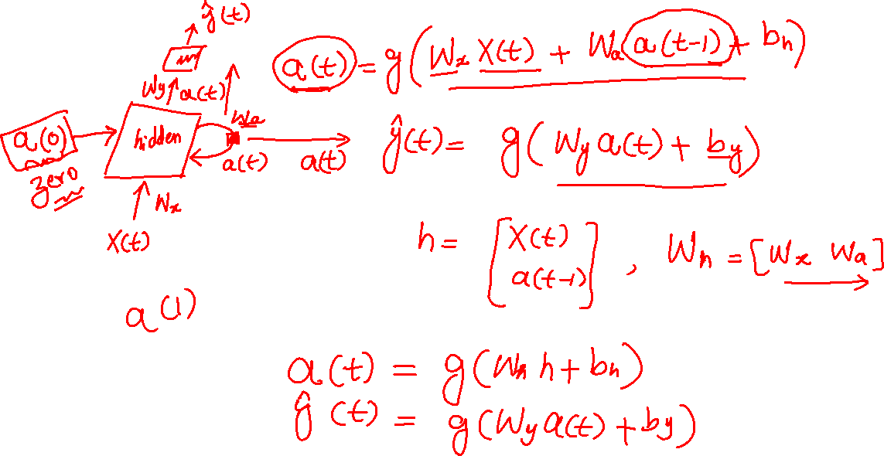
RNN Model (Notations)
Notes:
13

Slide 14
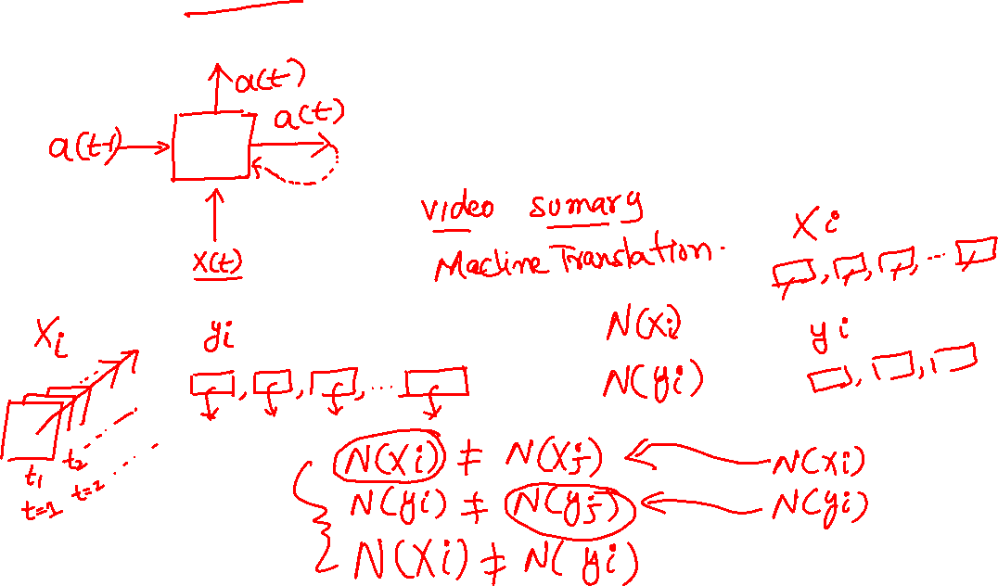
RNN Model (Types)
Notes:
14

Slide 15
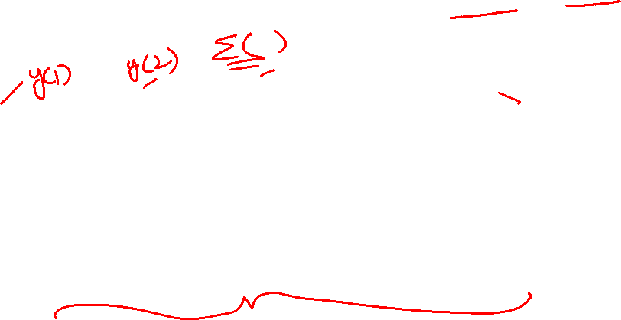
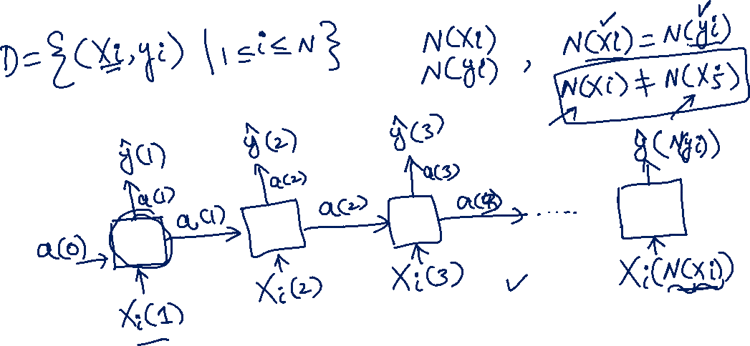
RNN Model (Notations)
Notes:
15

Slide 16
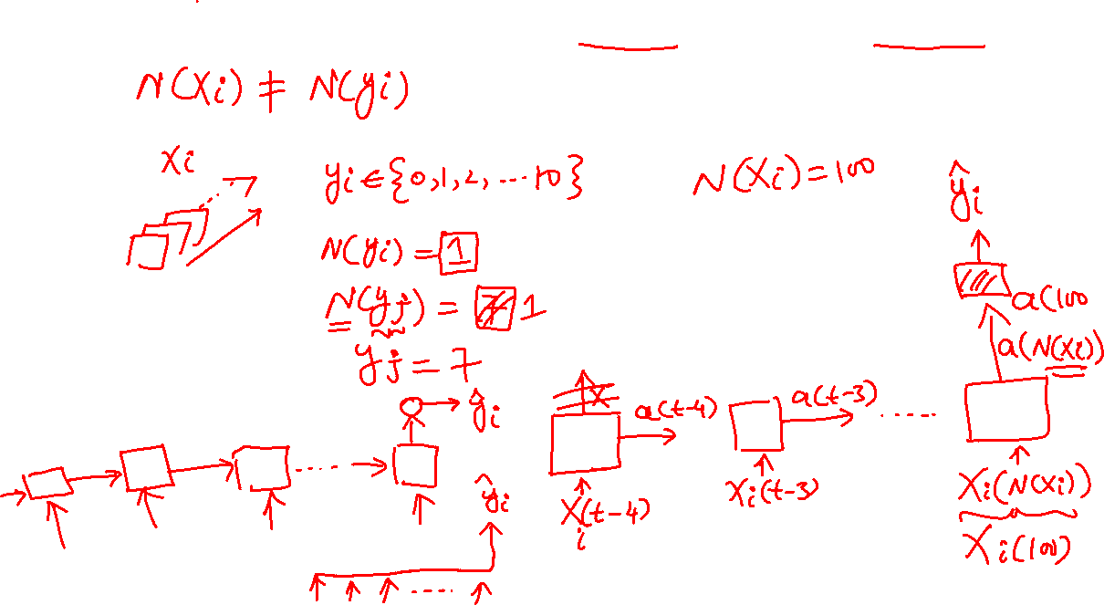
RNN Model (Many to One)
Notes:
16

Slide 17
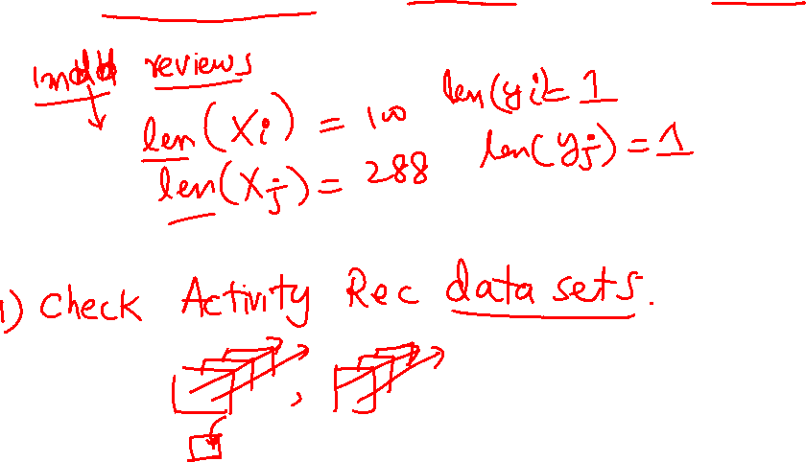
Activity: (Many to One)
Notes:
17

Slide 18
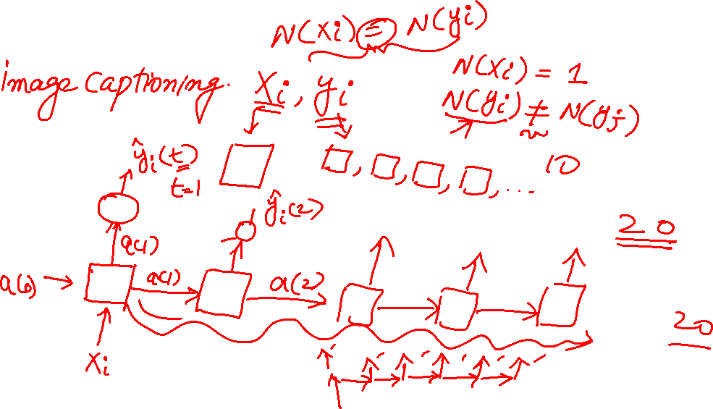
RNN Model (One to Many)
Notes:
18

Slide 19
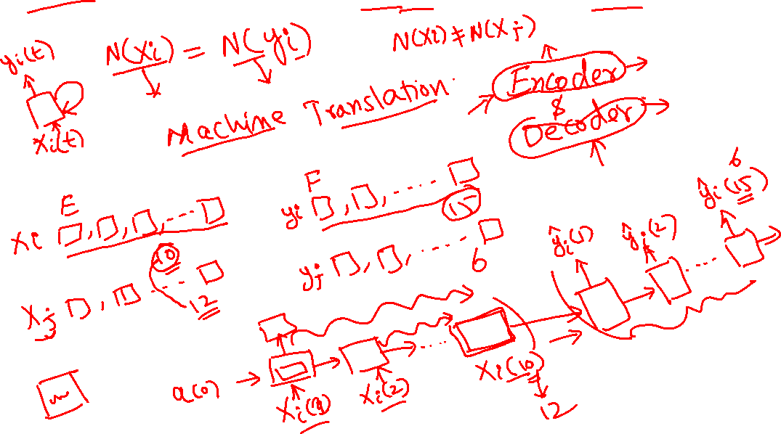
RNN Model (Many to Many)
Notes:
19

Slide 20
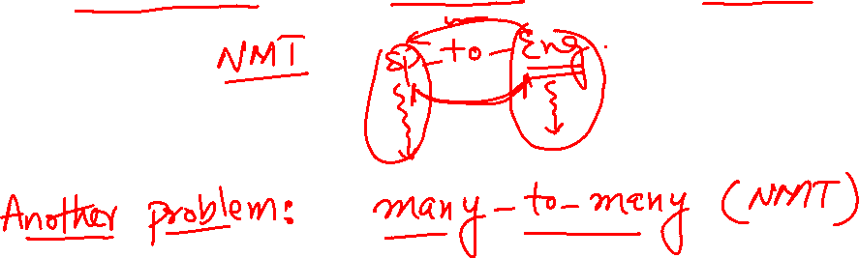
Activity: (Many to Many)
Notes:
20

Slide 21
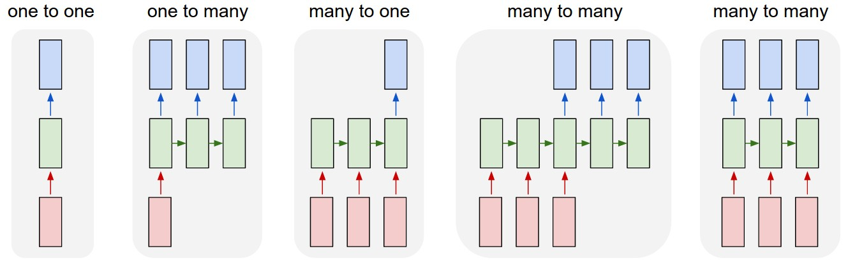

RNN Model Summary
Courtesy: Andrej Karpathy
Notes:
21

Slide 22
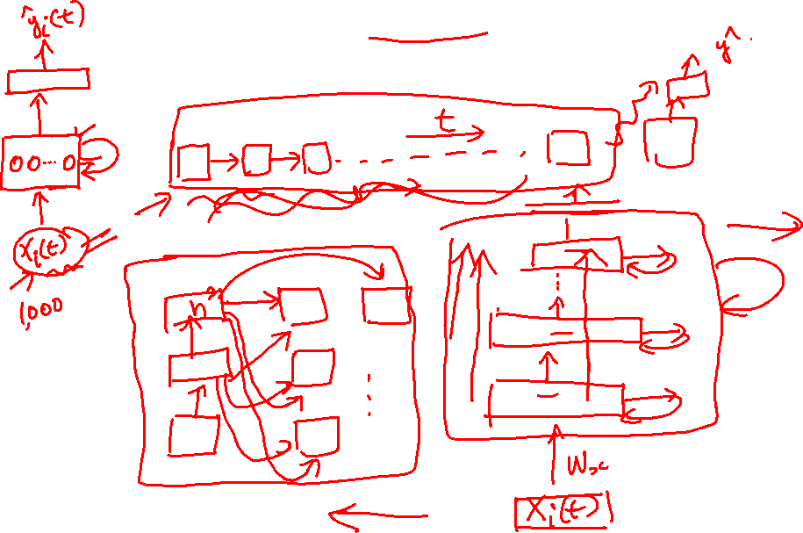
Deep RNN Model
Notes:
22

Slide 23
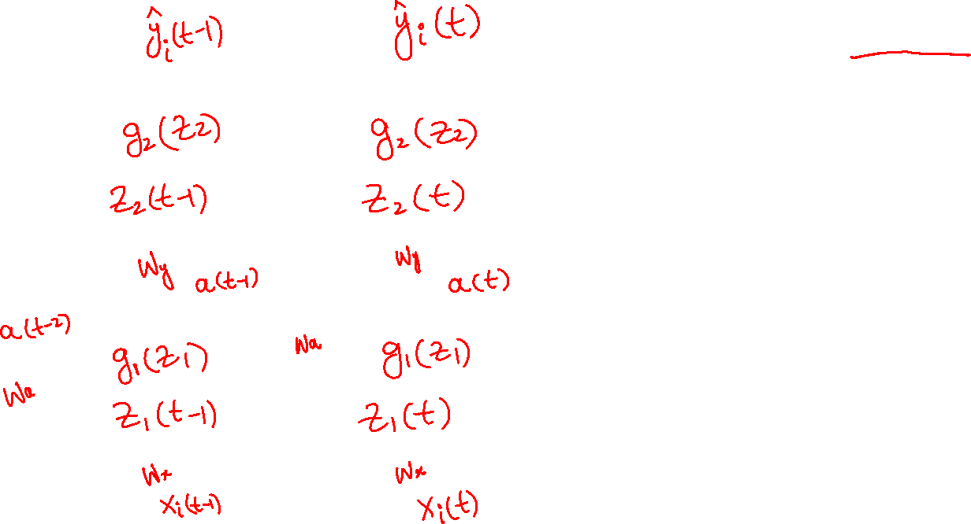
BPTT
Notes:
23

Slide 24
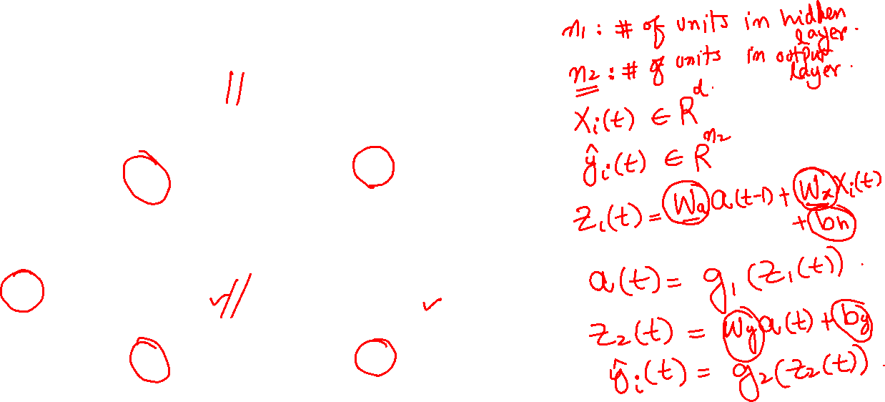
BPTT
Notes:
24

Slide 25
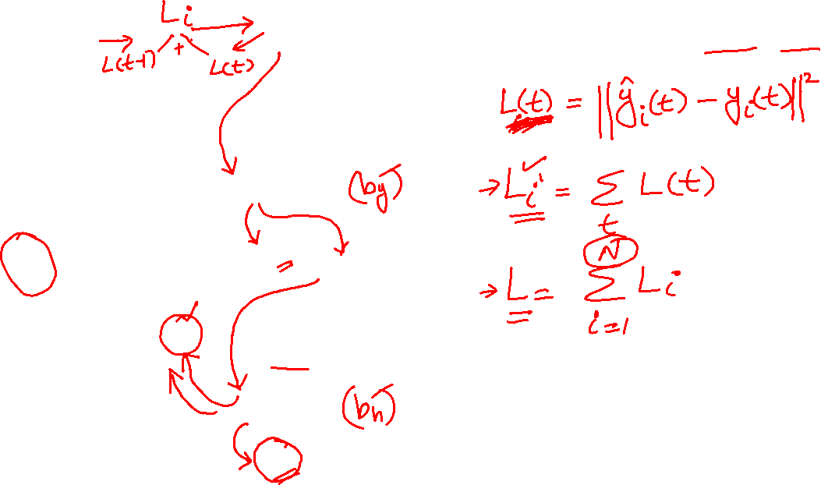
BPTT
Notes:
25

Slide 26

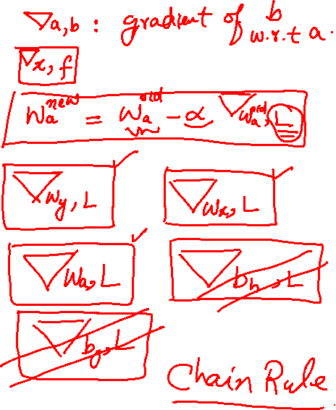
BPTT
Notes:
26

Slide 27
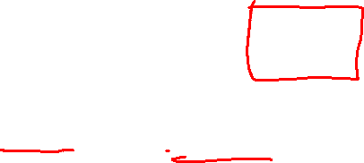
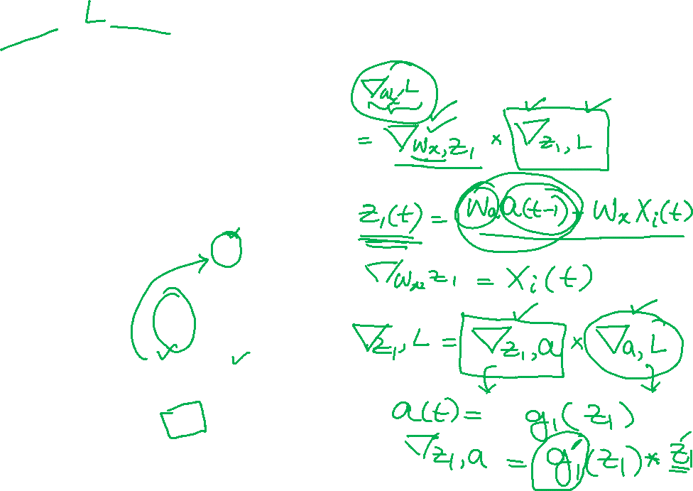

BPTT
Notes:
27

Slide 28
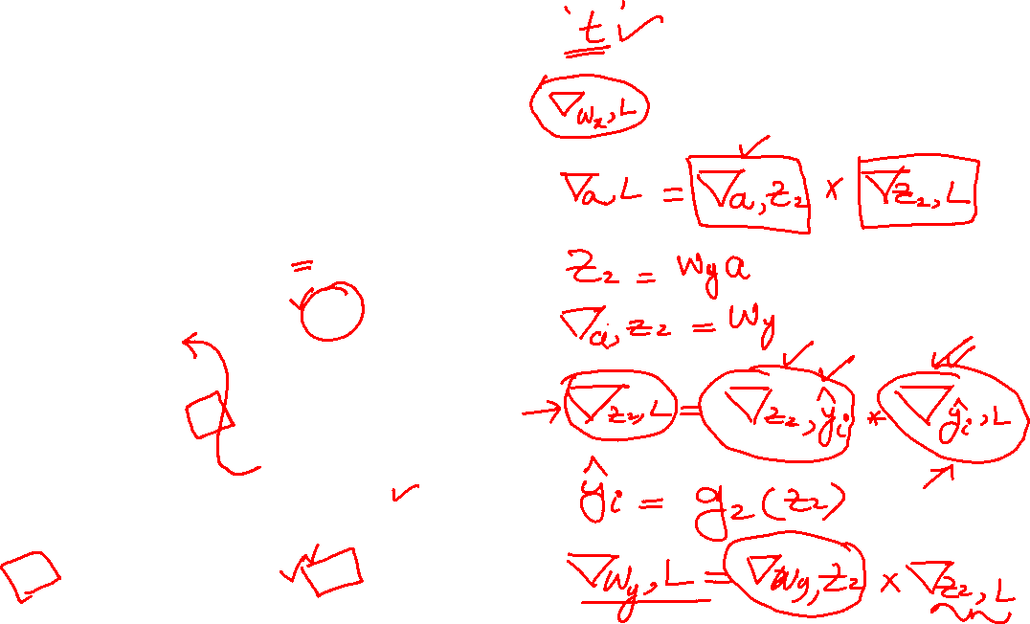
BPTT
Notes:
28

Slide 29
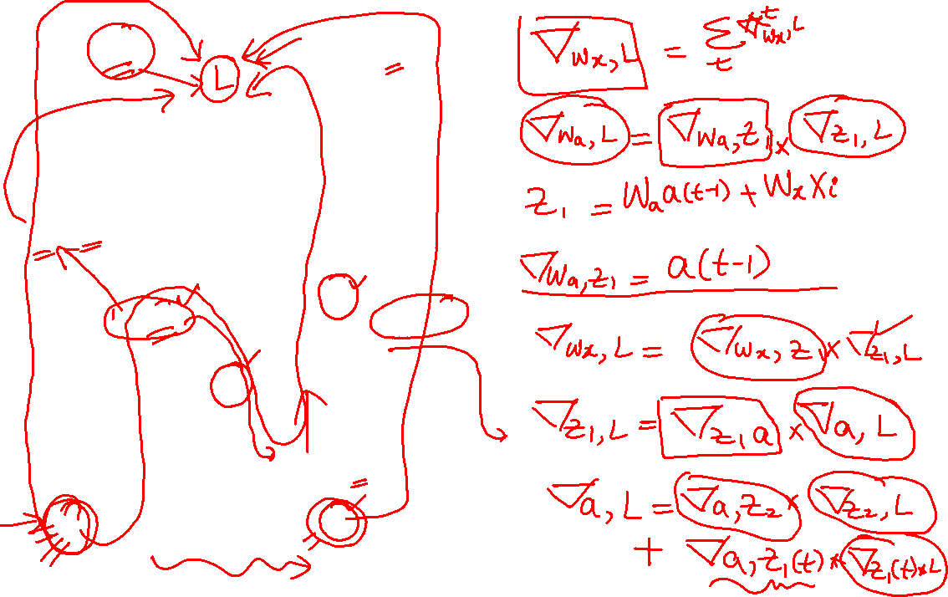
BPTT
Notes:
29

Slide 30
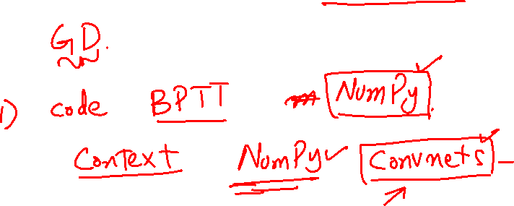
Activity
Notes:
30

Slide 31
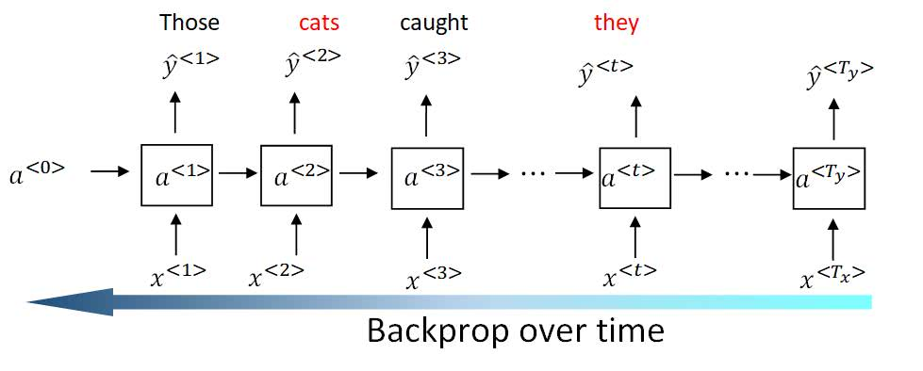
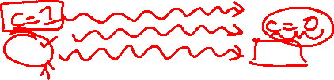
Vanishing Gradient in RNN
Courtesy: dlology.com
Notes:
31

Slide 32

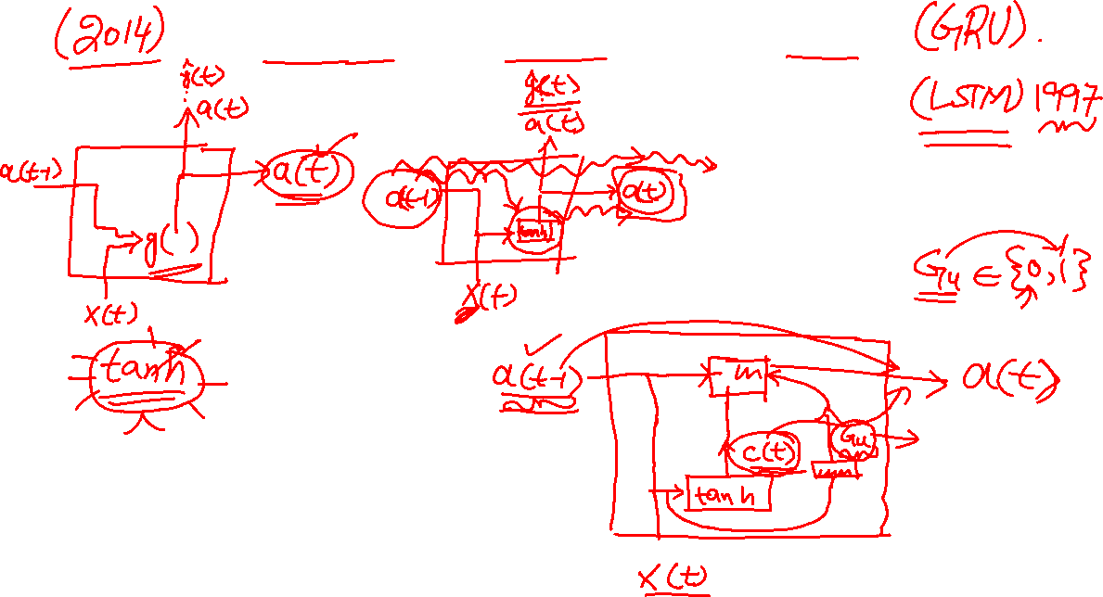
Gated Recurrent Unit
Notes:
32

Slide 33
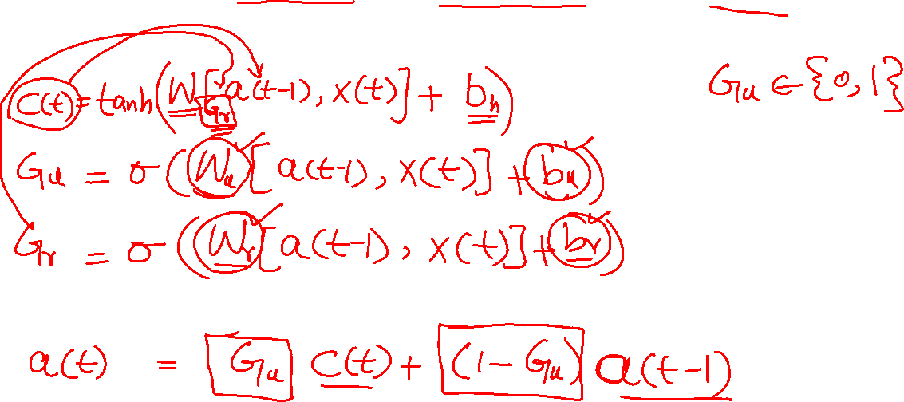
Gated Recurrent Unit
Notes:
33

Slide 34
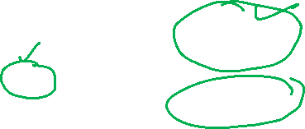
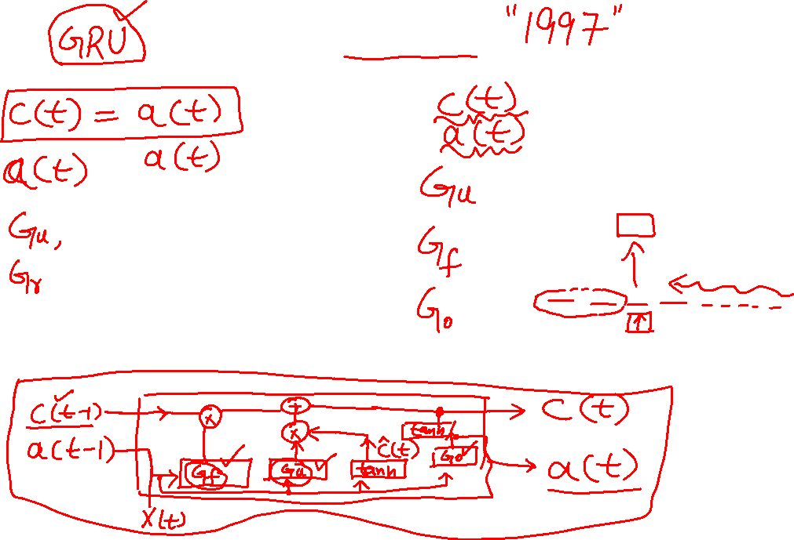
LSTM
Notes:
34

Slide 35
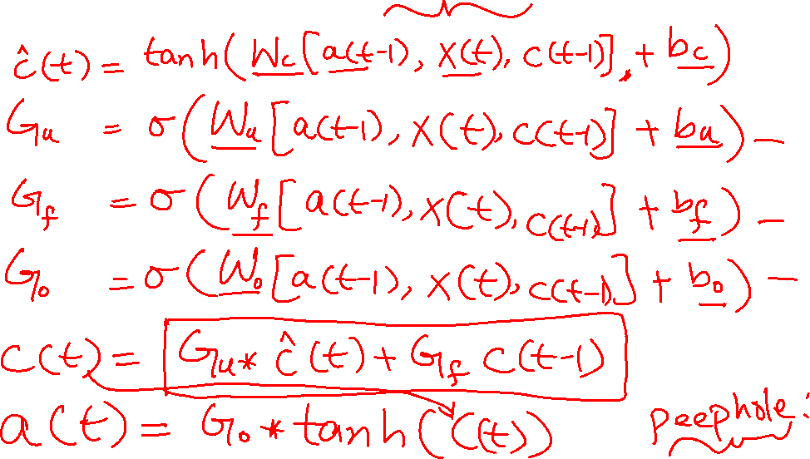
LSTM
Notes:
35

Slide 36
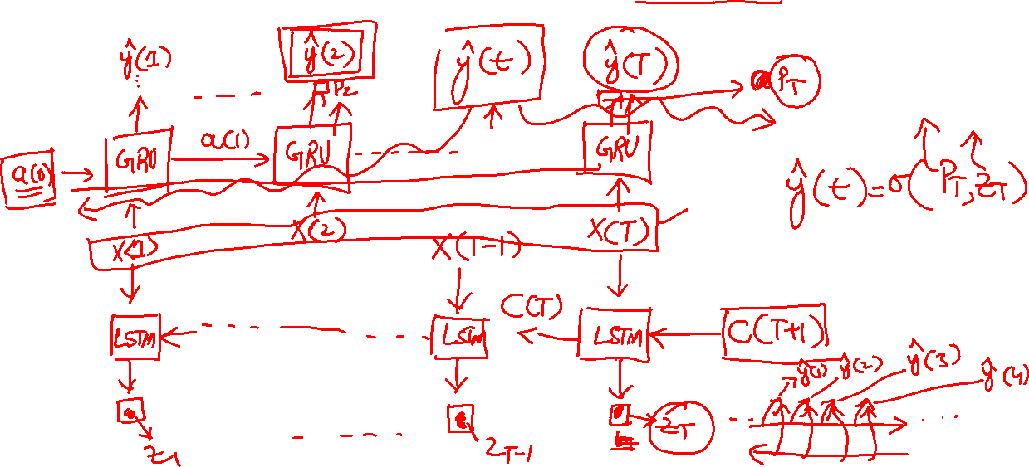
Bidirectional RNN
Notes:
36

Slide 37
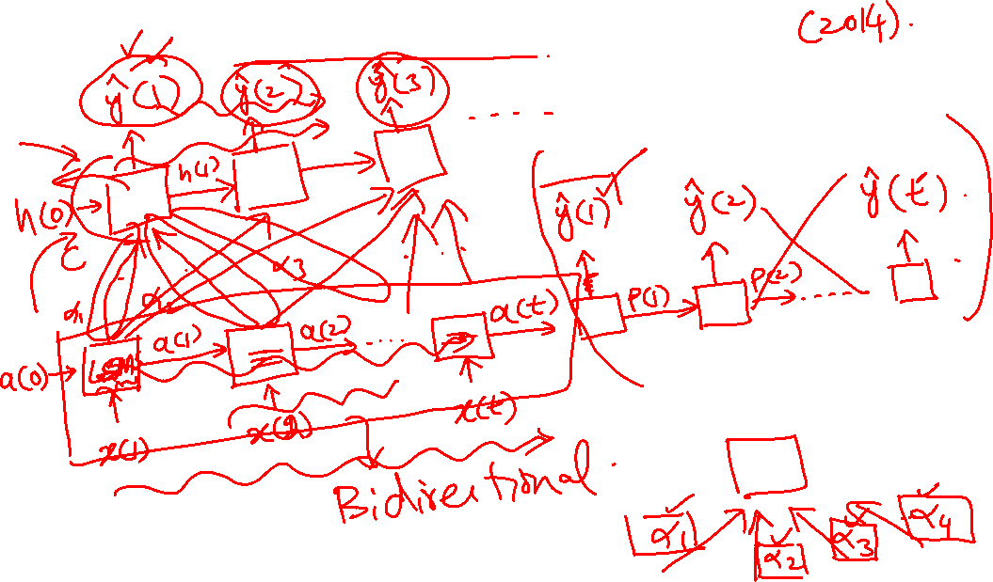
Attention Model
Notes:
37

Slide 38
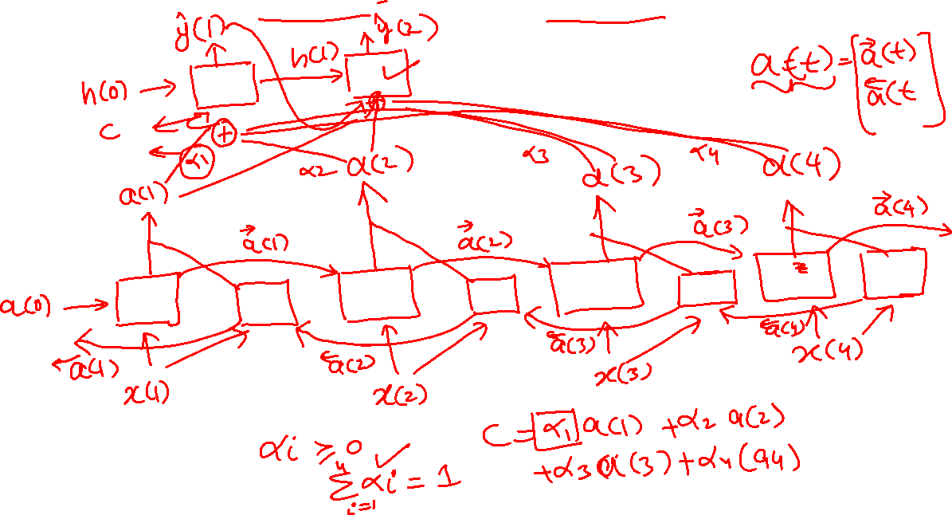
Attention Model
Notes:
38

Slide 39
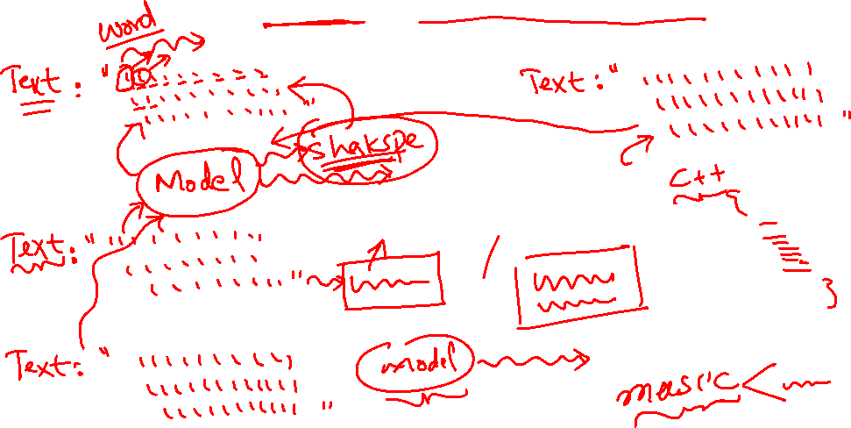
Text Generation
Notes:
39

Slide 40

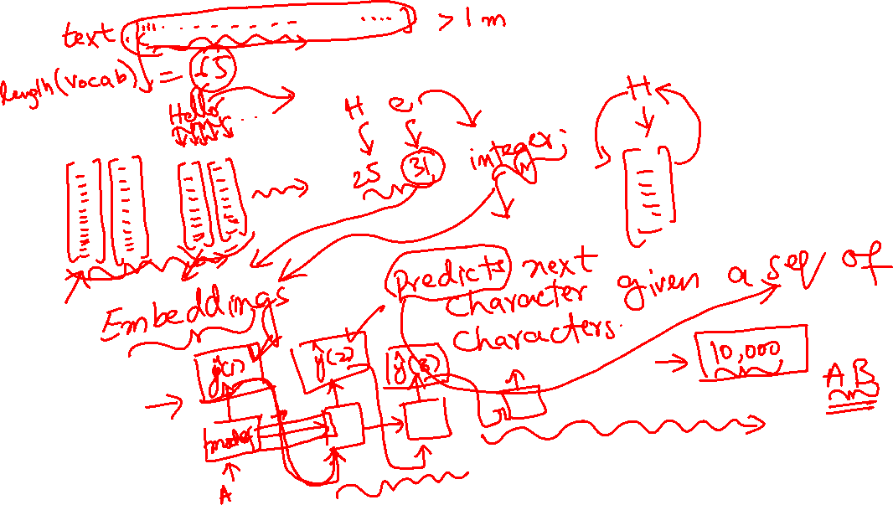
Text Generation
Notes:
40

Slide 41
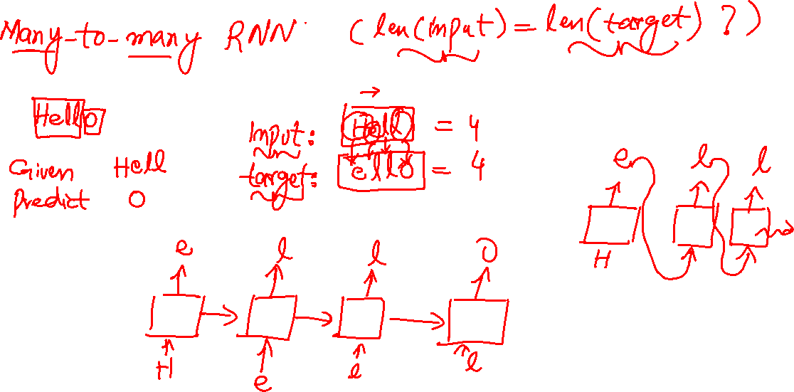
Text Generation
Notes:
41

Slide 42
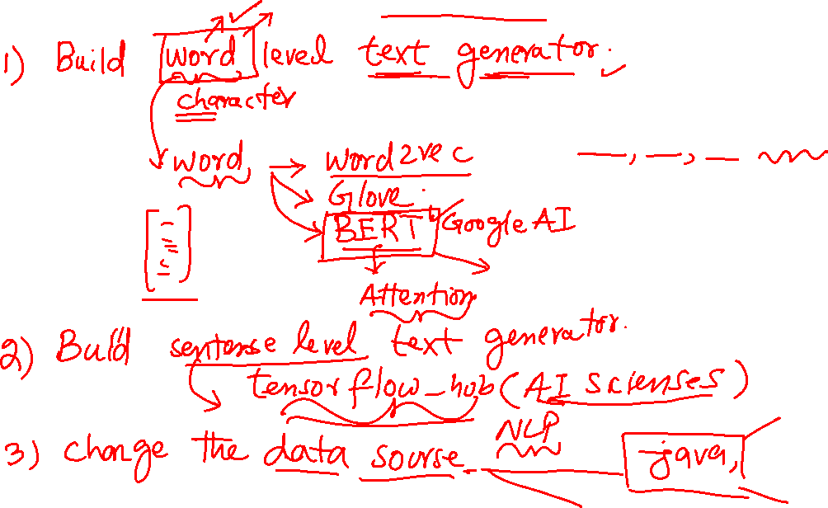
Activity
Notes:
42

Slide 43
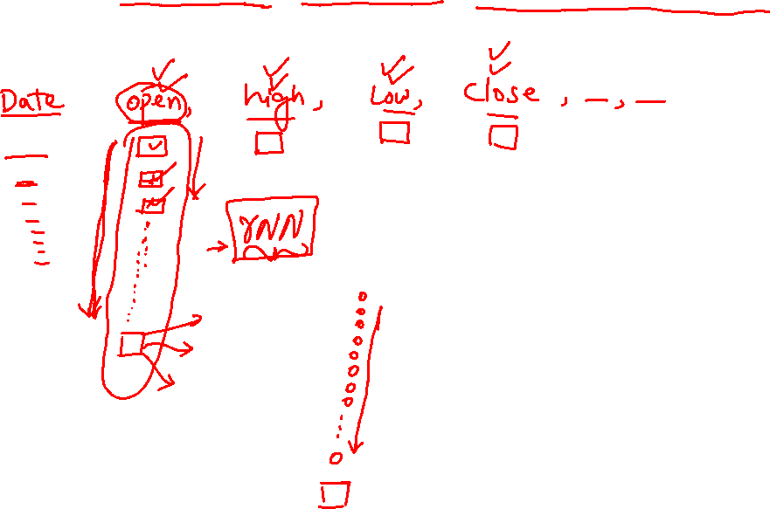
Stock Price Prediction
Notes:
43

Slide 44
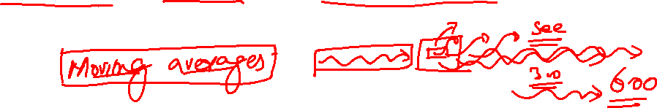
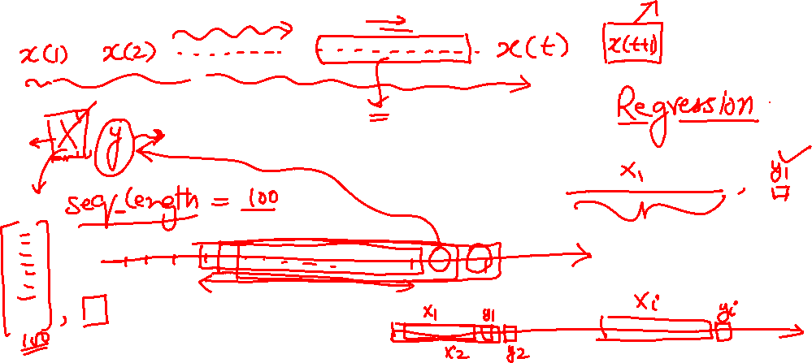
Stock Price Prediction
Notes:
44

Slide 45
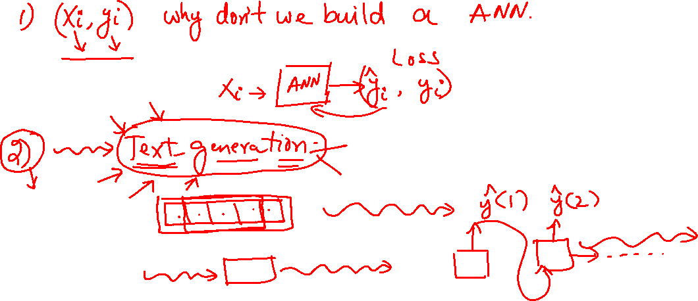
Activity
Notes:
45

Slide 46
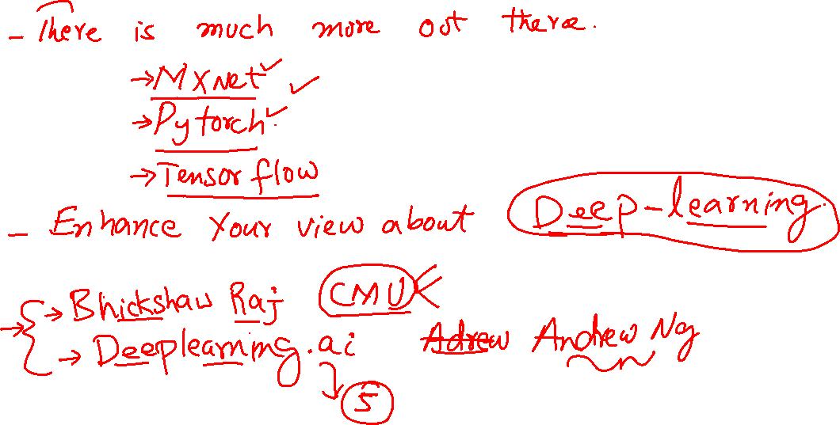
Further readings
Notes:
46

